Slide 1
computing apprenticeships
Computing and Technology Faculty of Business, Law and Digital Technologies
UG Version 2019
martin.reid@solent.ac.uk

Slide 2

Martin Reid
Course Leader & Apprenticeship Programme Manager BSc (Hons) Digital and Technology Solutions (Apprenticeships), and Course Leader for Computing Foundation, BSc (Hons) Digital Design and Development, and MSc Digital Design
Office: JM506
martin.reid@solent.ac.uk
Computing and Technology Faculty of Business, Law and Digital Technologies
Solent University - Southampton

Slide 3

KENTON WHEELER
Associate Lecturer in Computing
Office: JM506
kenton.wheeler@solent.ac.uk
Computing and Technology Faculty of Business, Law and Digital Technologies
Solent University - Southampton

Slide 4

Melina Brothers
Senior Business Engagement Officer
melina.brothers@solent.ac.uk

Slide 5


Welcome
Solent University Campus Commitment statement Requirements of the apprenticeship standard Information and communication Introduction to the academic delivery Grading and assessments Portfolio Off the job tracker Review meetings Gateway endpoint assessment (EPA) Student support Q & A

Slide 6
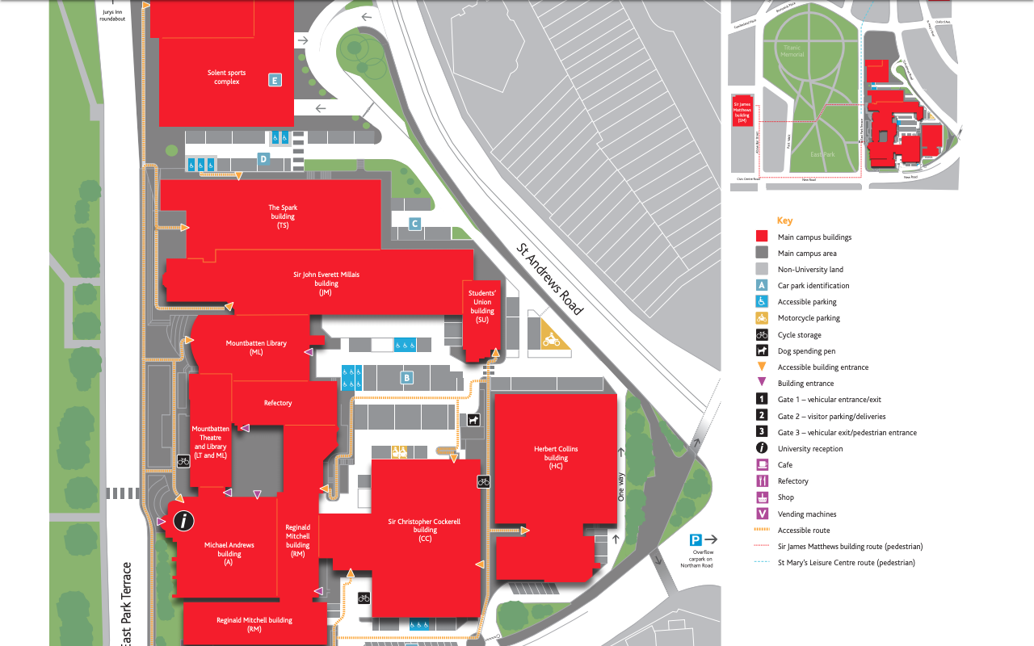
JM Building
Computing Staff Team
JM506
Students
Union

Slide 7
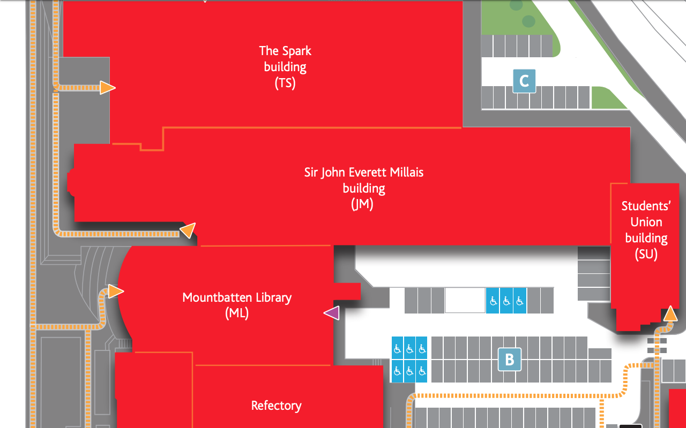

Slide 8
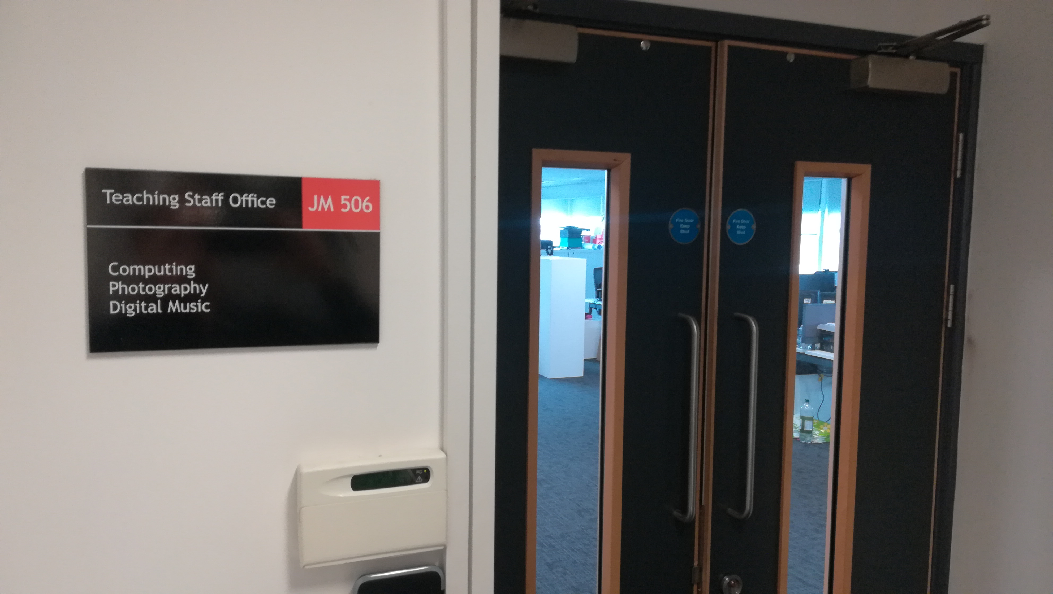
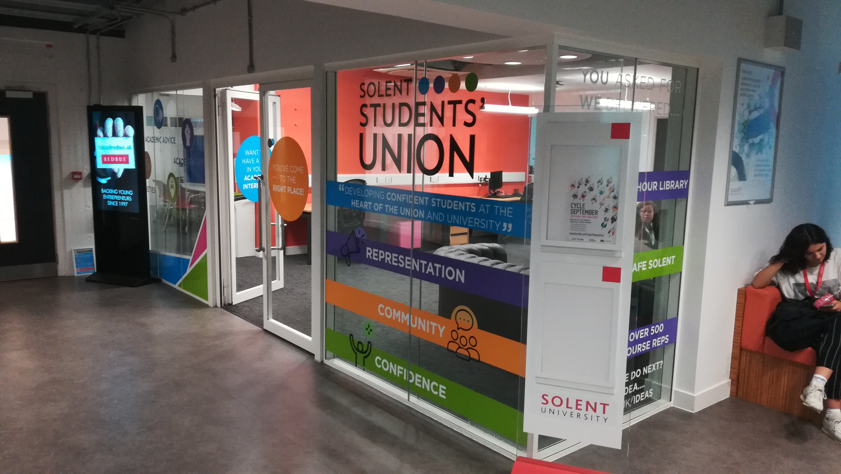
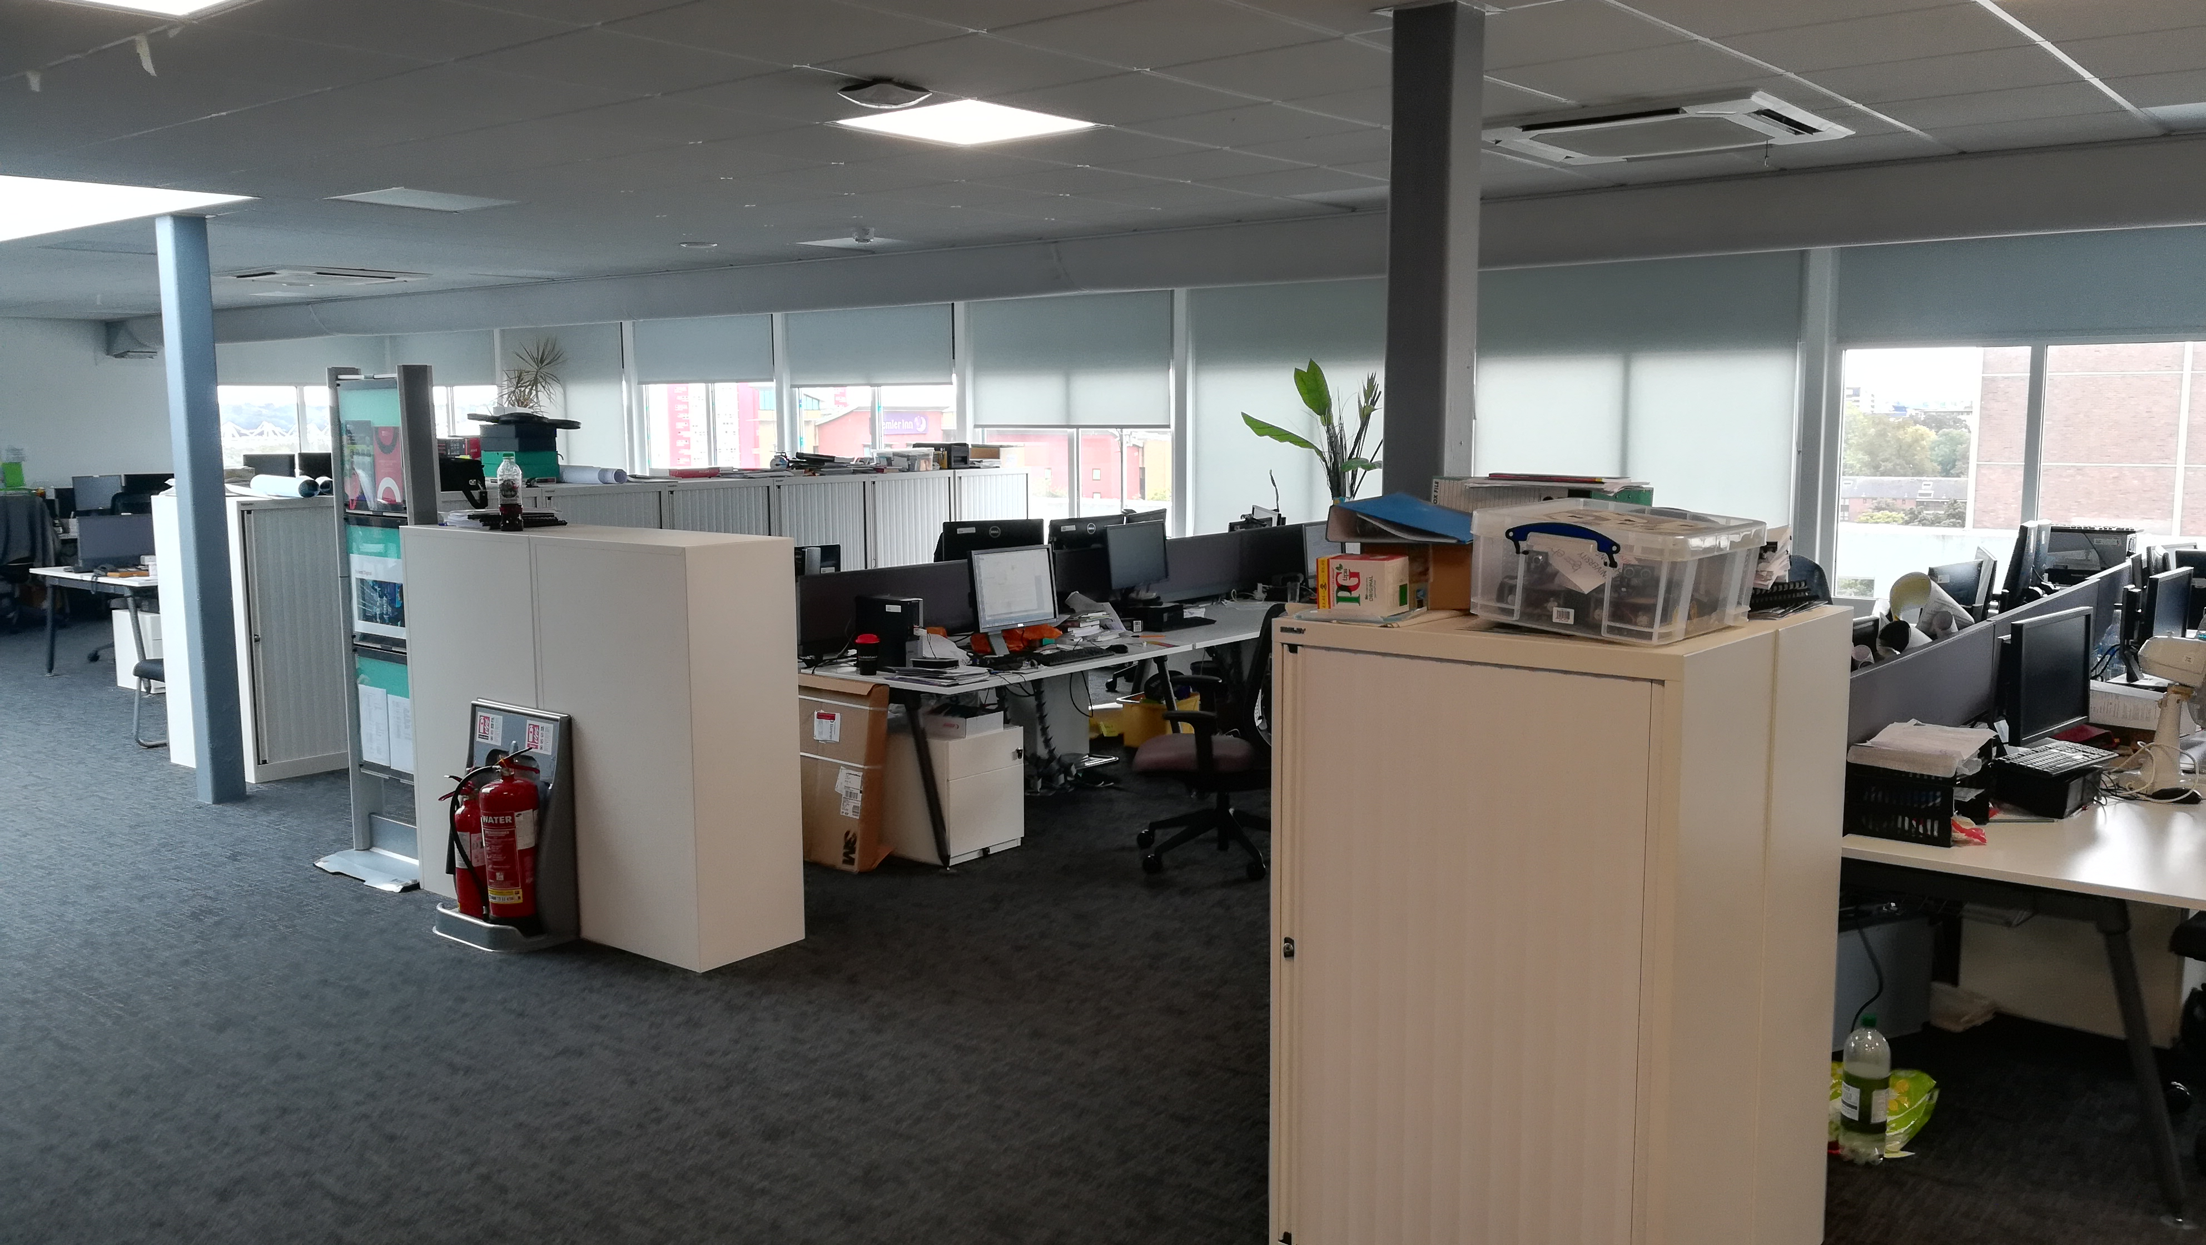
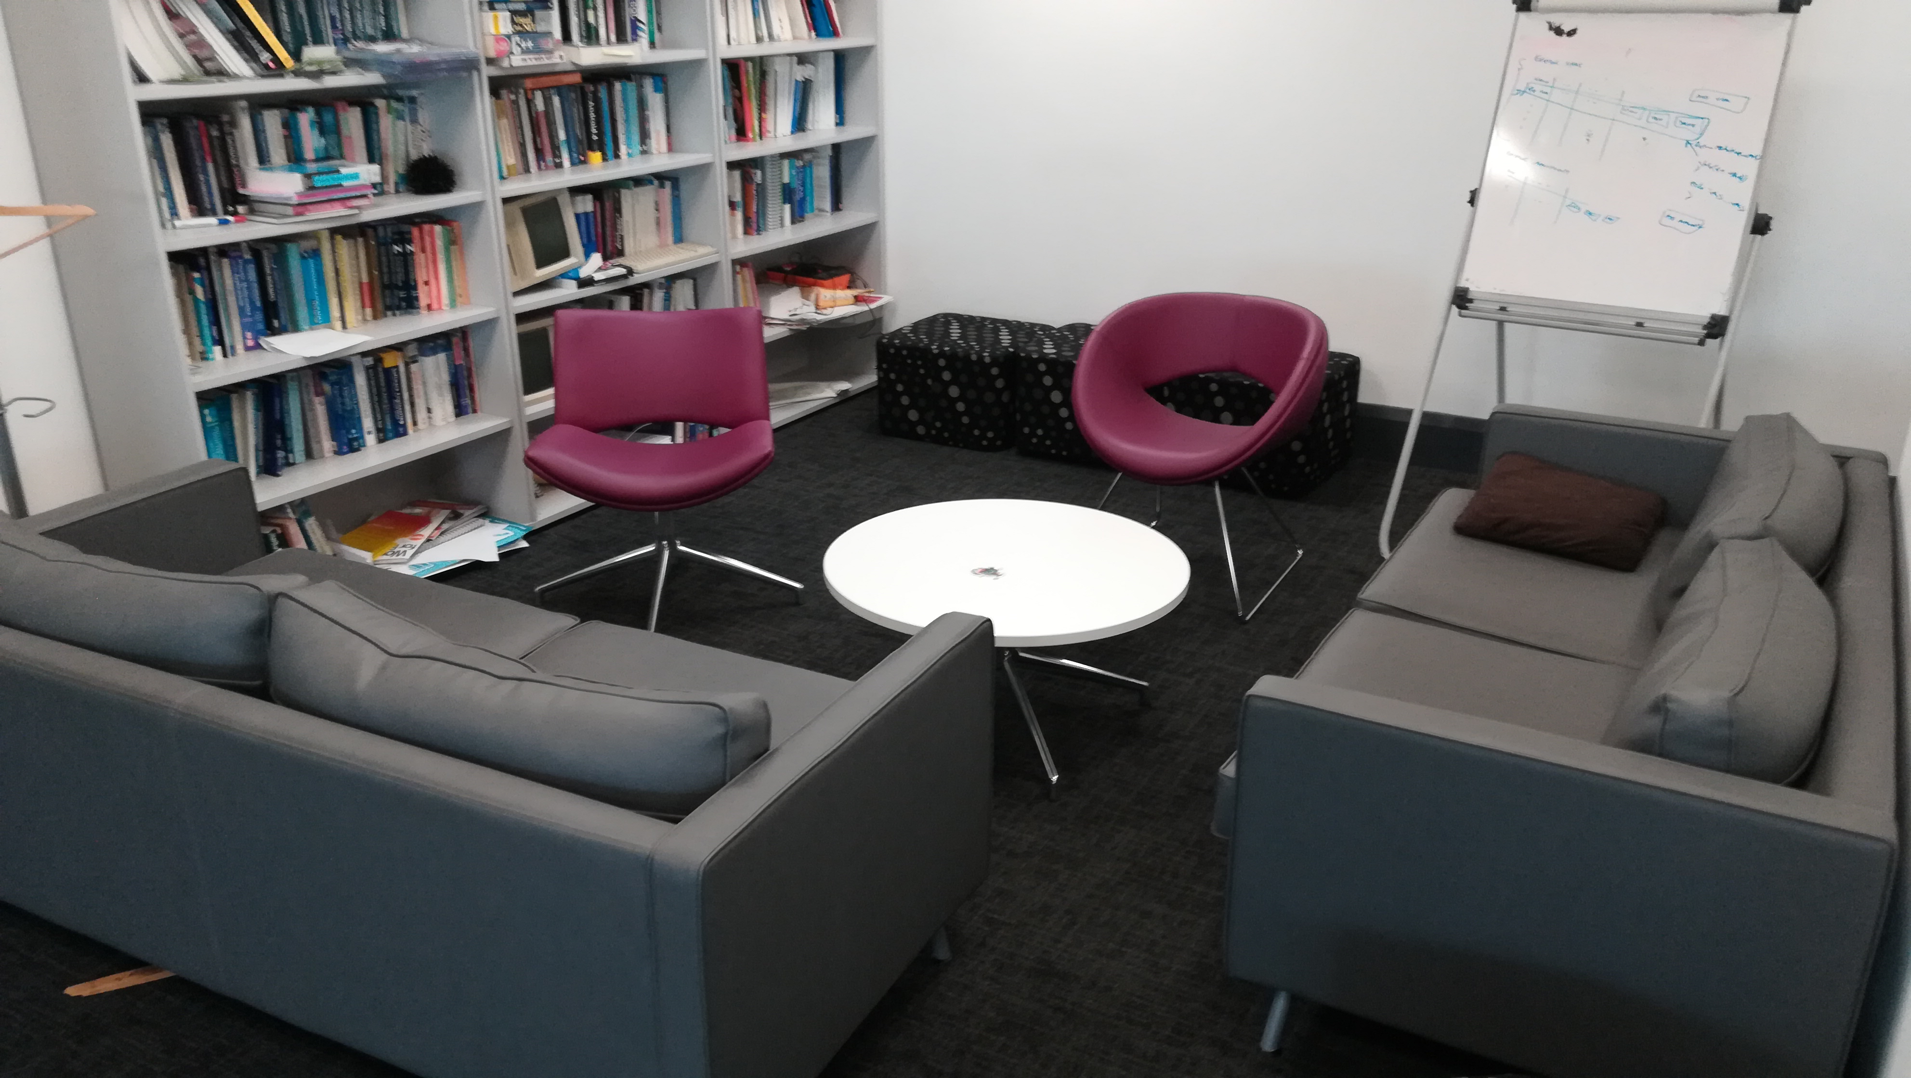

Slide 9

Commitment statement This is a tripartite agreement between the employer, apprentice and the University
It details:
The course content and schedule
what is expected and offered by the employer, the training provider and the apprentice
how to resolve queries or complaints
agreement for negotiated costs with your employer and the endpoint assessment organisation

Slide 10
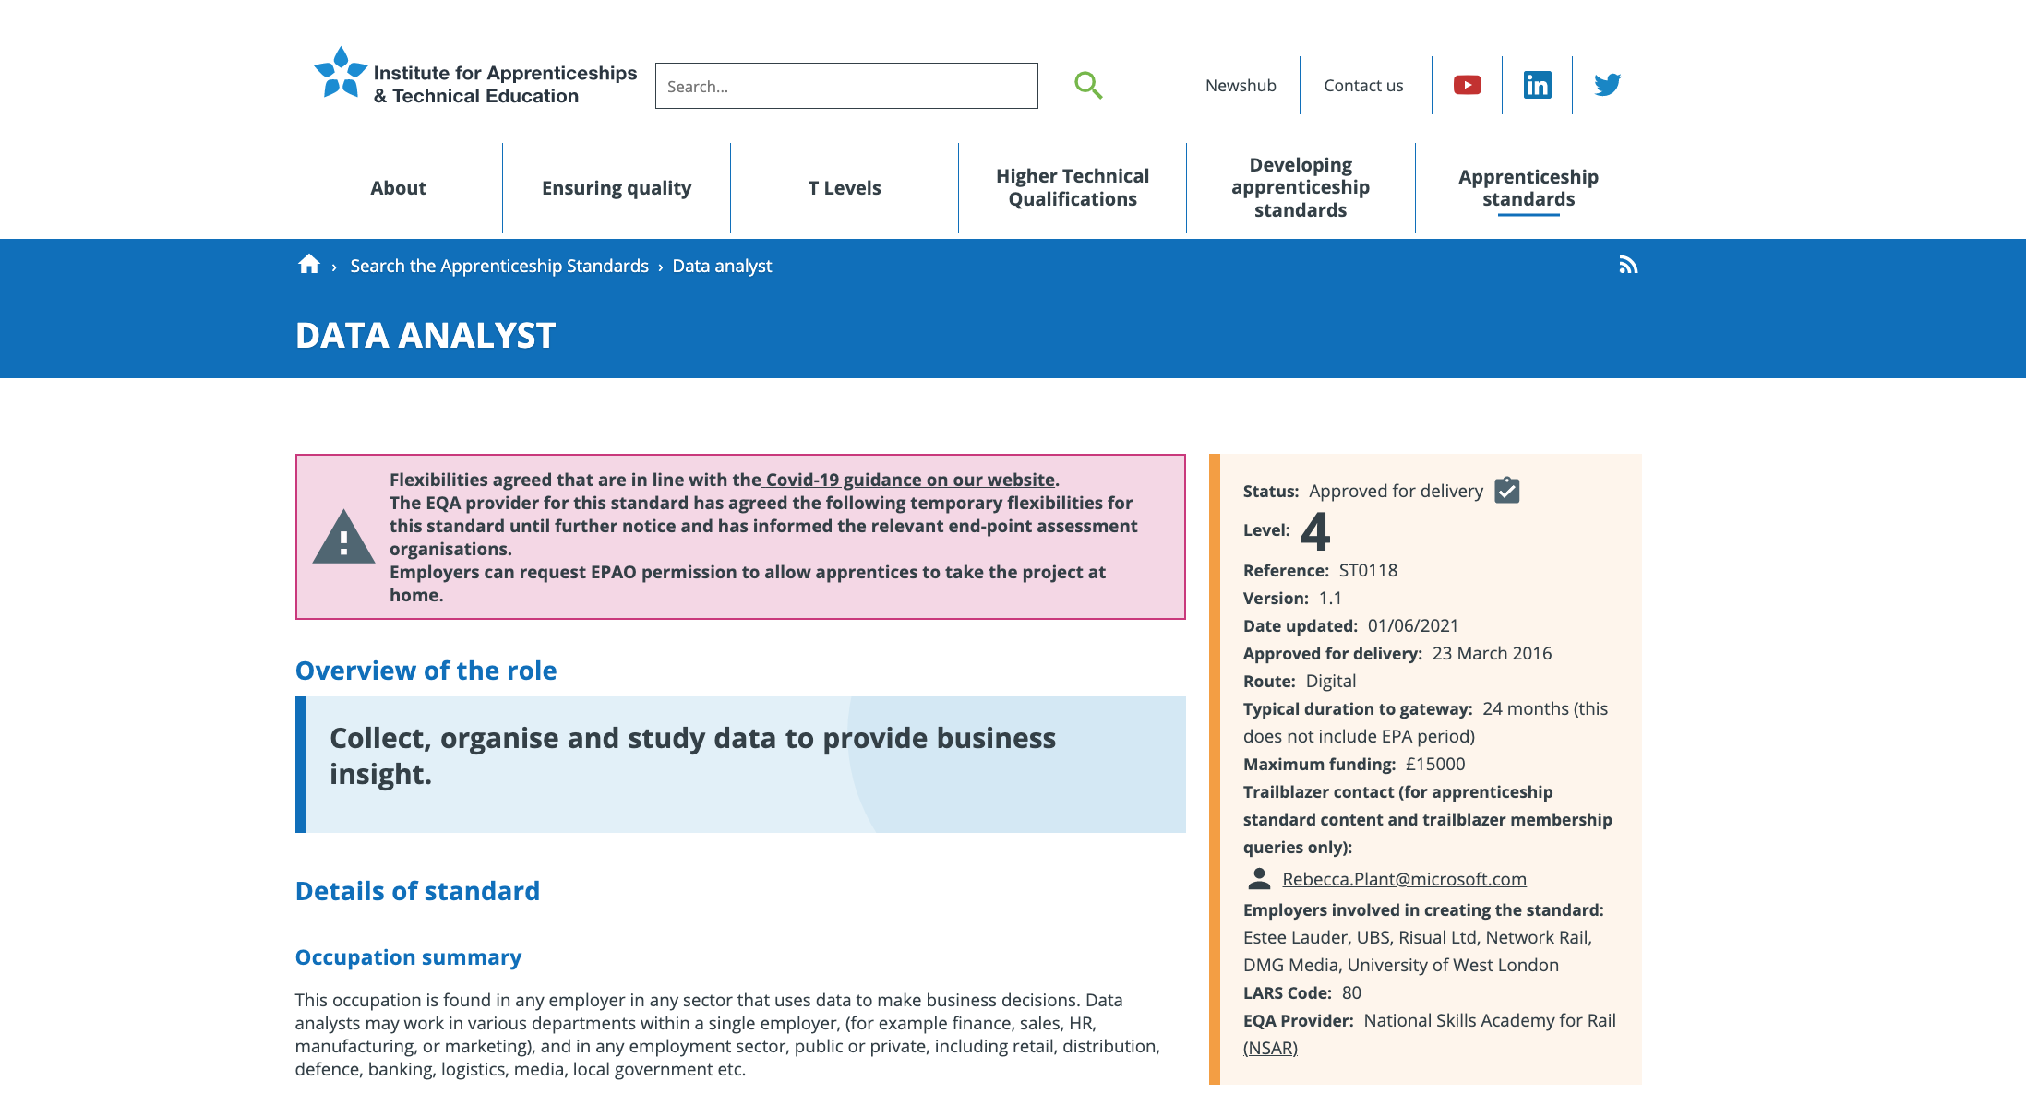
https://www.instituteforapprenticeships.org/apprenticeship-standards/data-analyst/

Slide 11
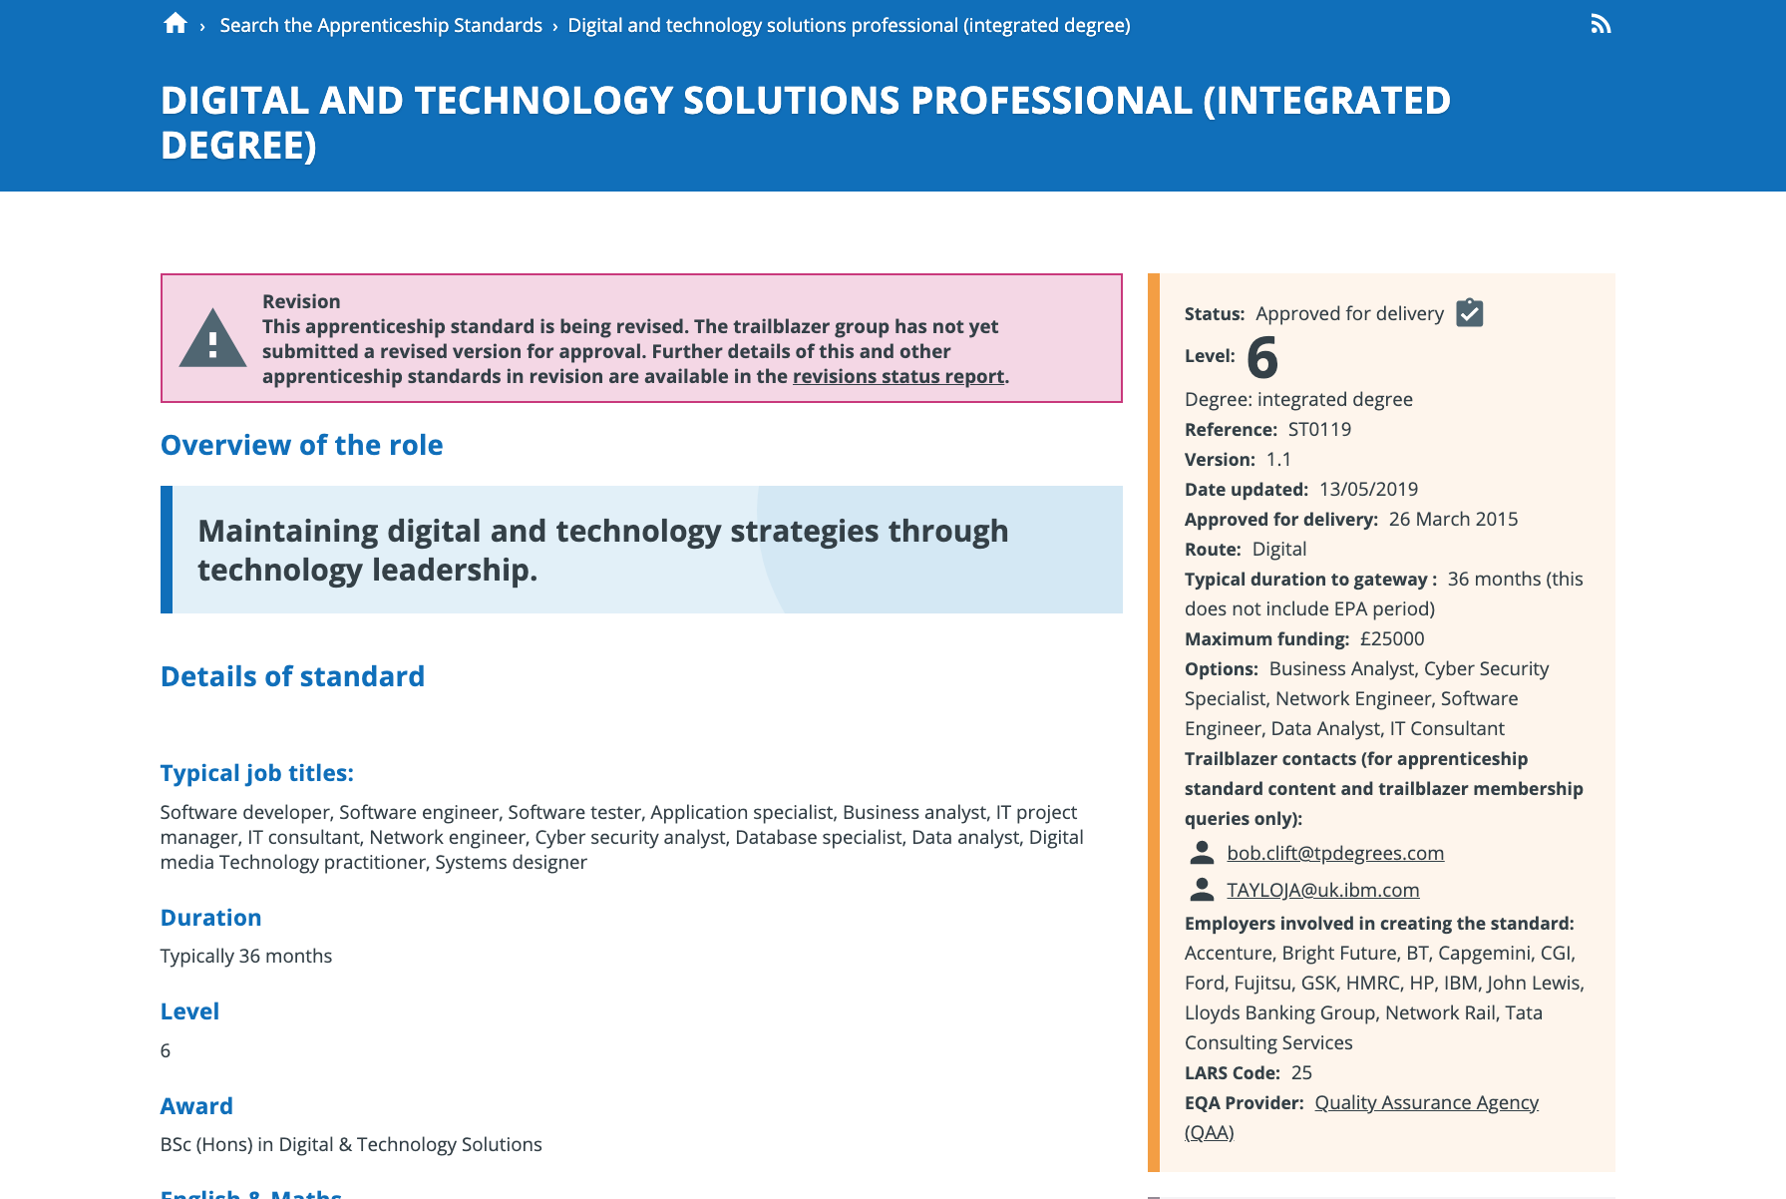
https://www.instituteforapprenticeships.org/apprenticeship-standards/digital-and-technology-solutions-professional-integrated-degree/

Slide 12
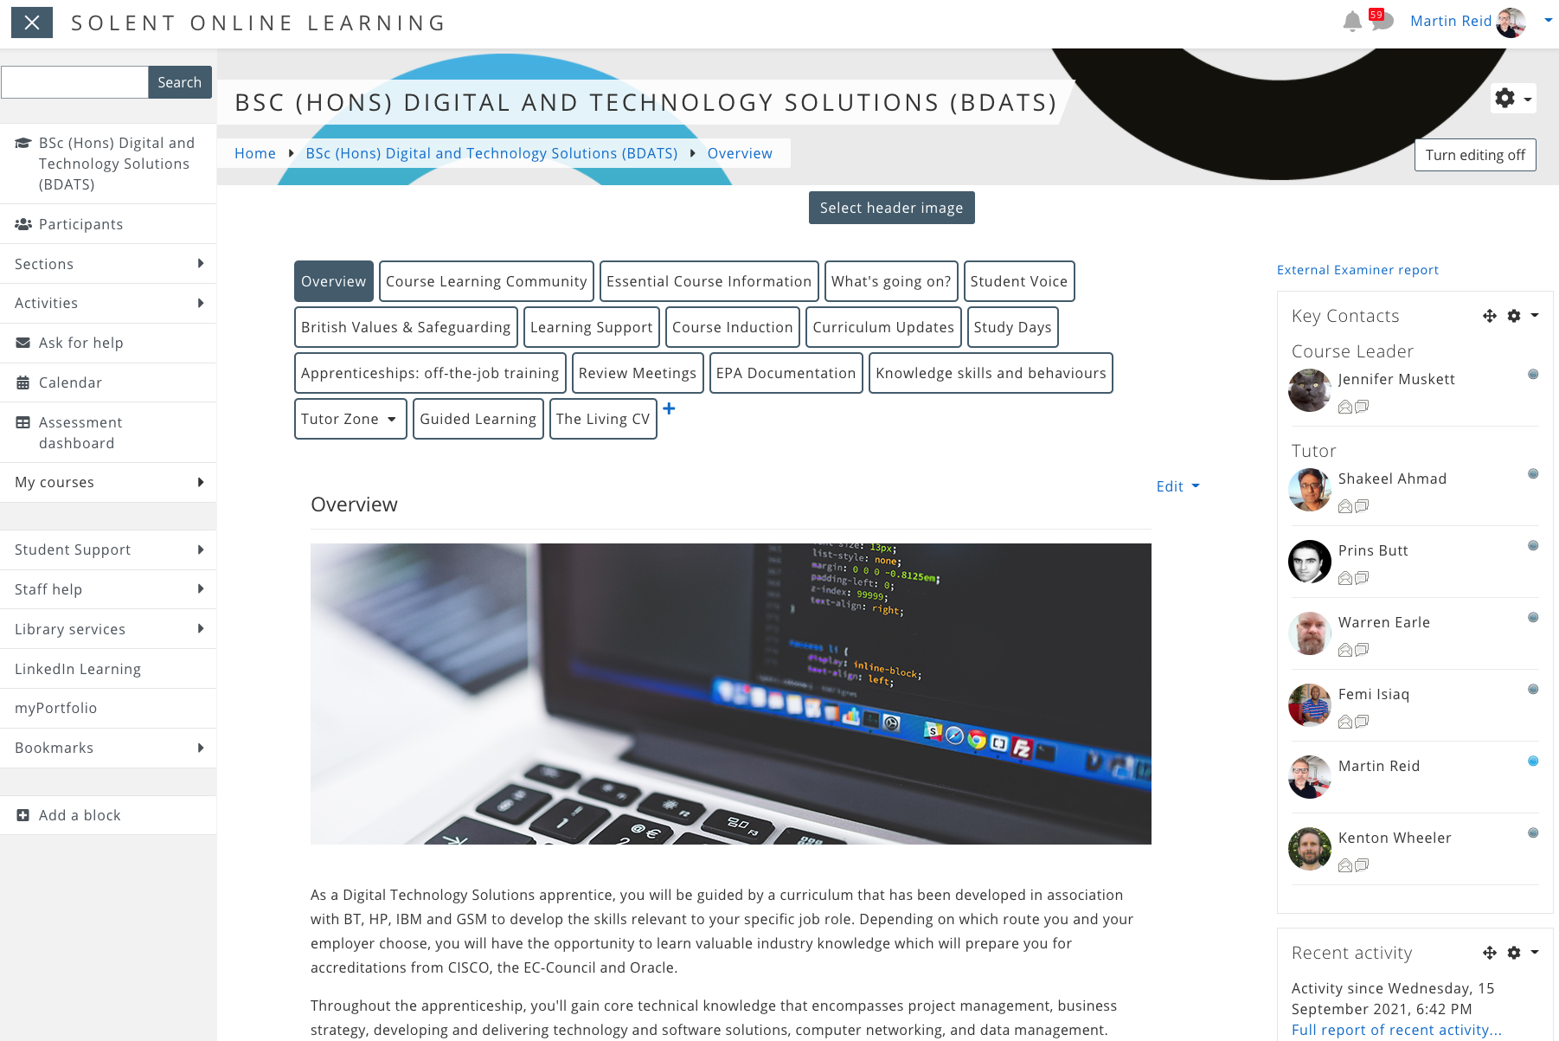
https://learn.solent.ac.uk/course/view.php?id=42080&section=0#tabs-tree-start

Slide 13
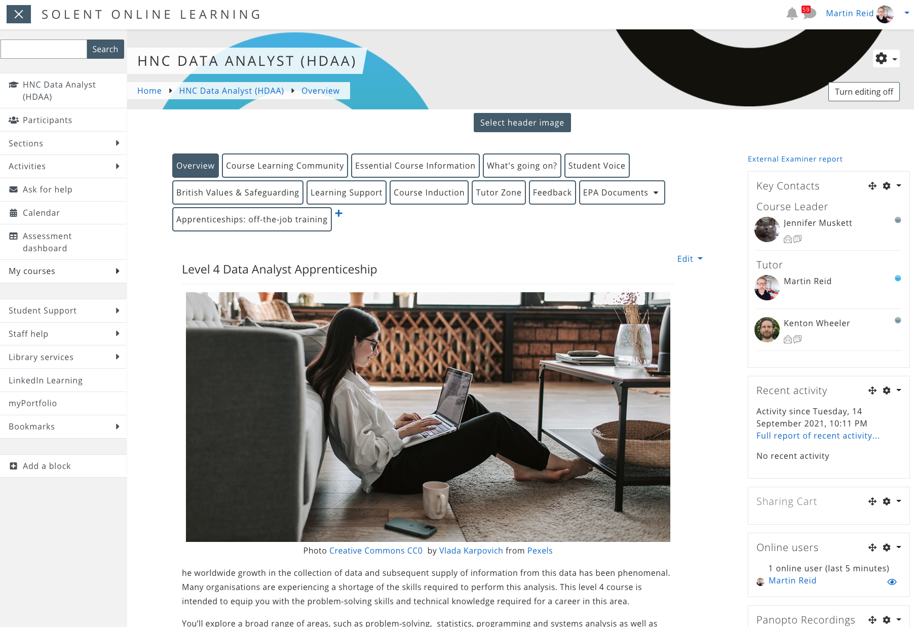
https://learn.solent.ac.uk/course/view.php?id=42256

Slide 14

https://learn.solent.ac.uk/course/view.php?id=22663&section=1#tabs-tree-start

Slide 15
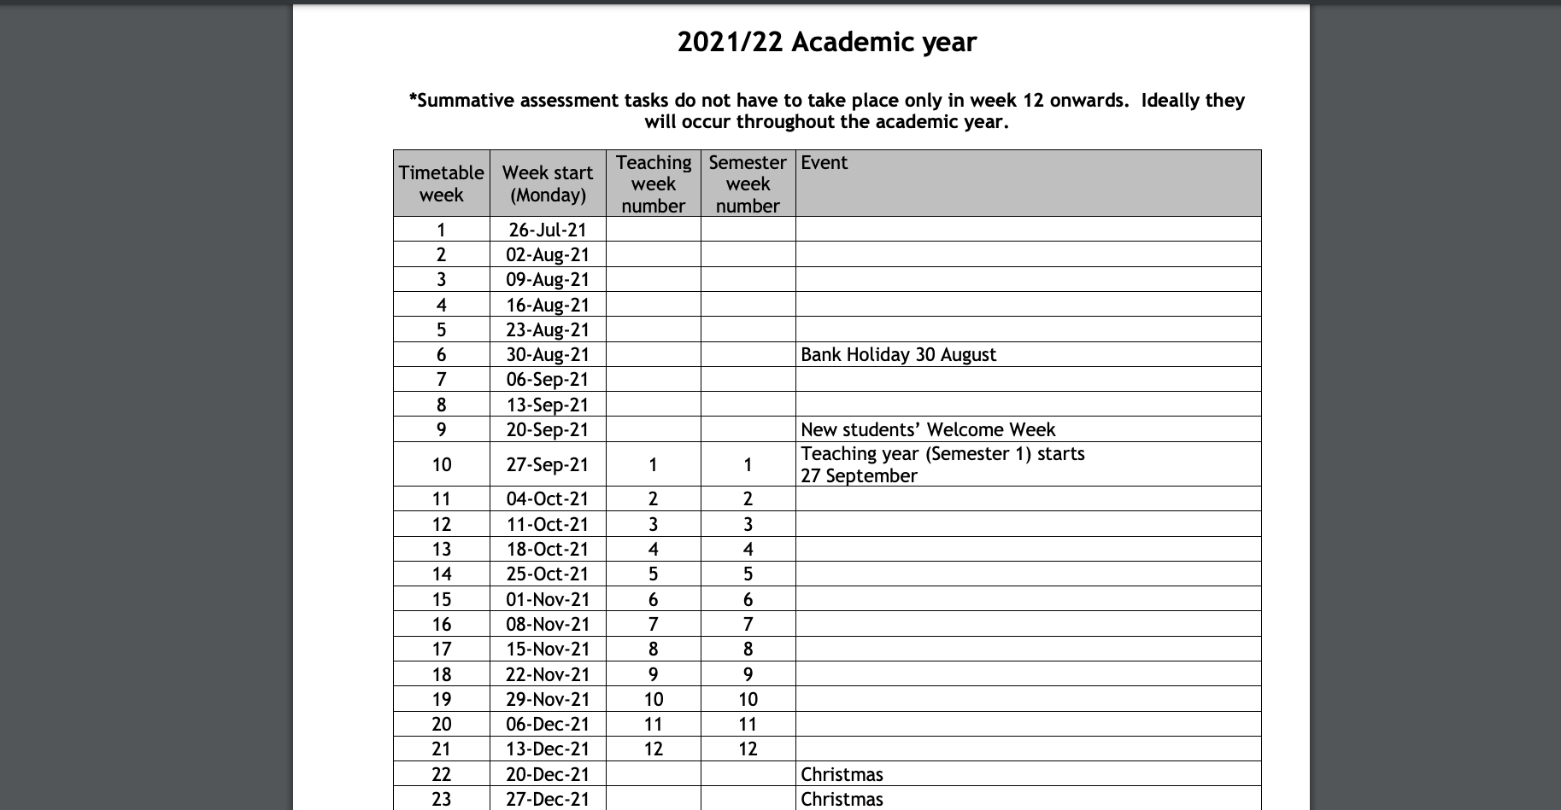
https://students.solent.ac.uk/official-documents/policy-governance-and-information/academic-calendar-2021-22.pdf

Slide 16
HNC Data Analyst Level 4
24 Months – on-programme 3 Semesters per year Study 1 module at a time 3 Months – Gateway EPA

Slide 17
HNC Data Analyst Level 4
 | Period 1 | Period 2 | Period 3
 | Autumn Sept – Jan | Spring Jan – May | Summer May – Sept | Oct – Dec
YR 1 | Problem Solving through Programming COM411 Introduction to Cyber Security* | Introduction to Databases COM417 | Systems Analysis & Design Work Based Project COM423 | n/a
YR 2 | Principles and Methods of Data Analysis COM4xx | Data Analysis, Tools and Application COM418 (COM407) | Computing Project | Gateway EPA
*complete the on-line Introduction to Cyber Security module before the Gateway process.

Slide 18
Digital and Technology Solutions (integrated degree)
36 Months – on-programme
3 Semesters Study 2 modules at a time (except the final semester) 3 Months – Gateway EPA

Slide 19
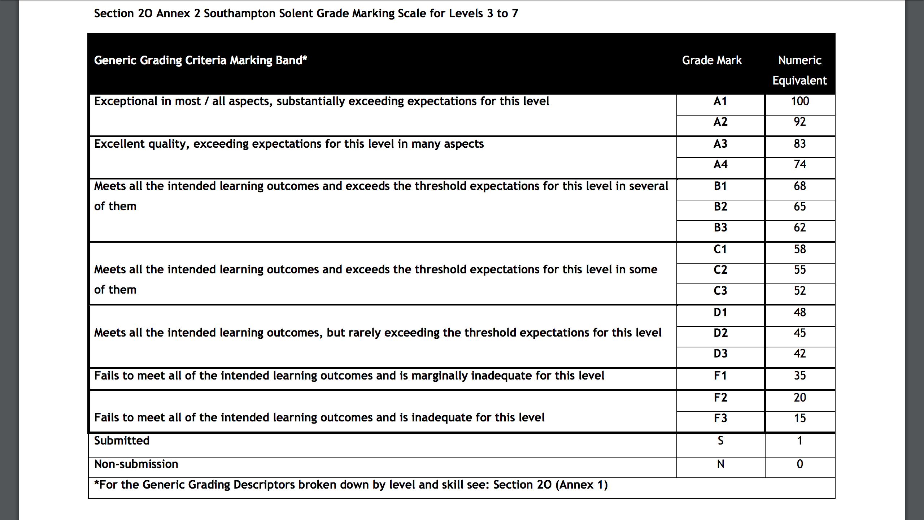

Slide 20
Grades from first year (Level 4) do not count to your final degree classification
D3 & above is a pass for coursework or average out with the numeric equivalent of 40 to pass a Module

Slide 21

PORTFOLIO

Slide 22

20% off the Job Tracker
https://learn.solent.ac.uk/course/view.php?id=42080&section=10#tabs-tree-start

Slide 23
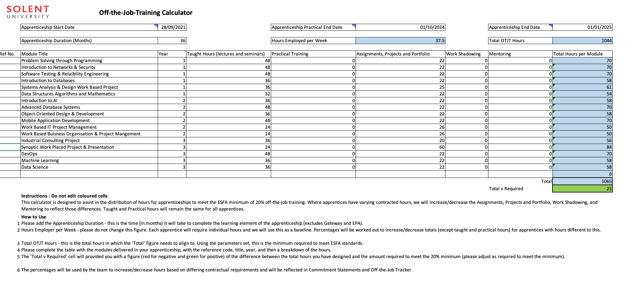

Slide 24
Review meetings
Tripartite review meetings take place regularly throughout the apprenticeship and are usually held every semester.
At tripartite review meetings the apprentice, their employer, and an academic formally meet to assess progress and ensure that the apprentice is on track both in terms of their academic programme and their work-based learning.
https://learn.solent.ac.uk/course/view.php?id=42080&section=11#tabs-tree-start

Slide 25
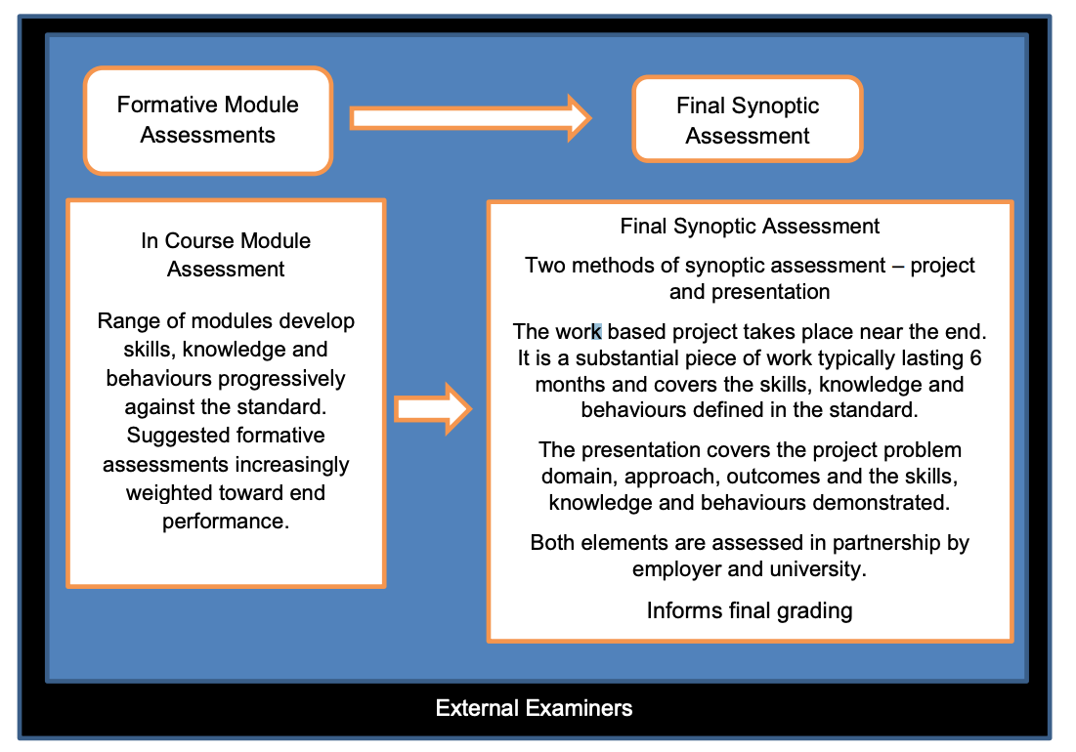
Endpoint Assessment – BSc Digital & Technology Solutions

Slide 26
Endpoint Assessment – HNC Data Analyst
Assessment Method 1 - Project with Presentation & Questioning
A 3,500 word detailed data analysis project designed to meets the needs of the business, delivering real business benefit.
A 20 minute presentation based on the submitted project followed by 20 minutes of questions by an Independent Assessor on the presentation and project.
Assessment Method 2 - Professional Discussion with Portfolio
A 60 minute two-way discussion underpinned by the portfolio, which involves both the Independent Assessor and the Apprentice actively listening and participating in a formal conversation.

Slide 27
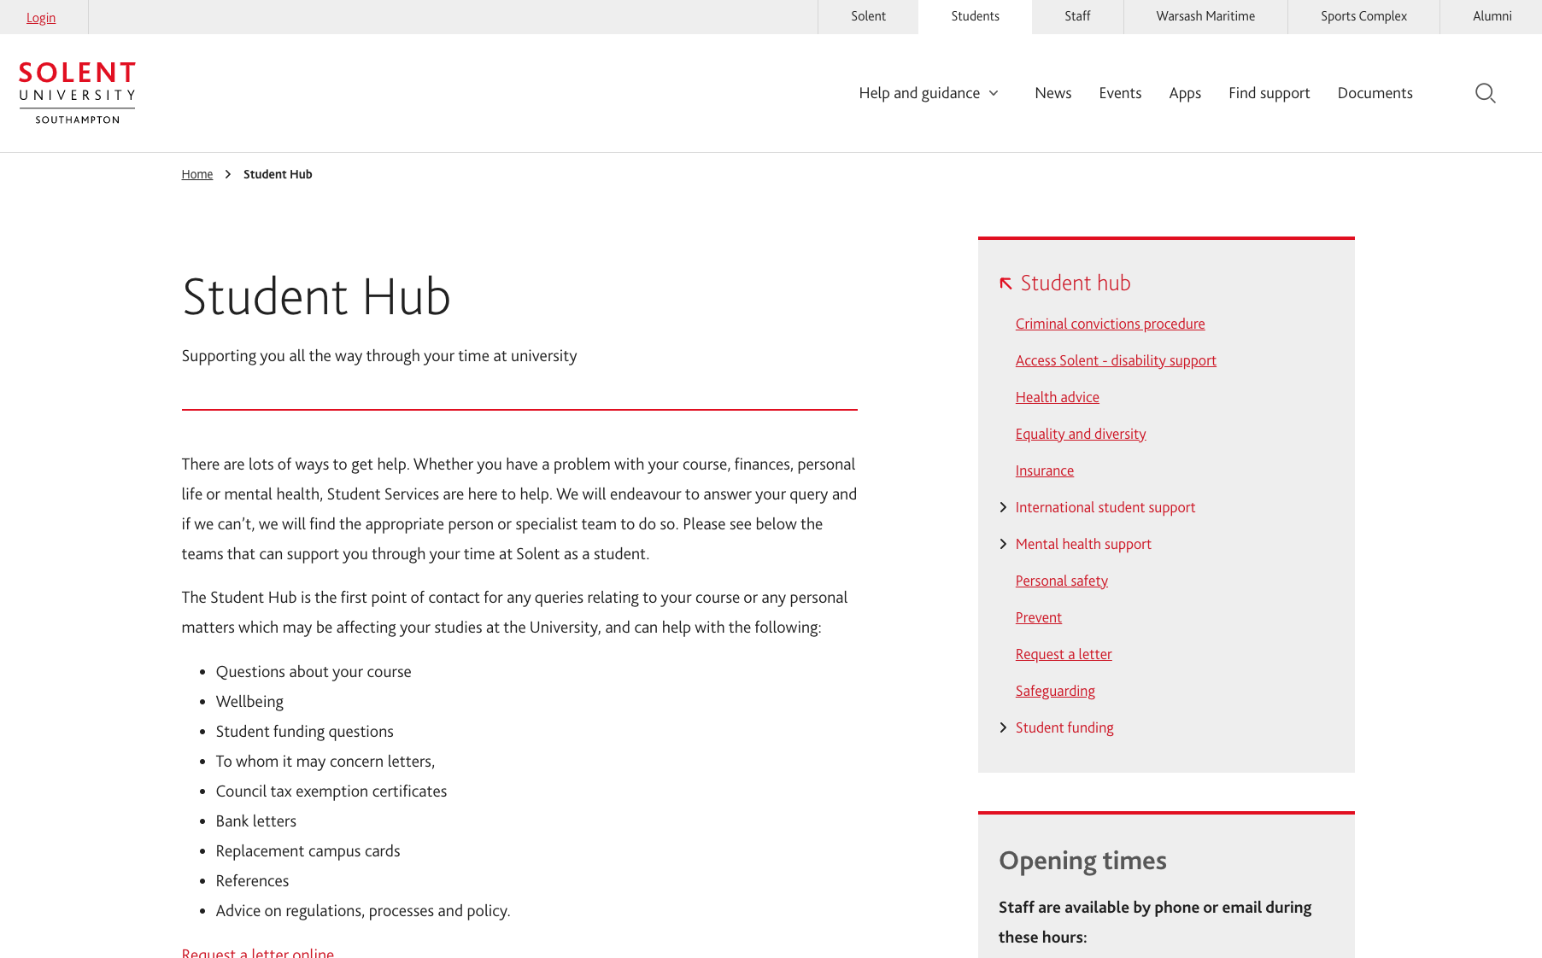
https://students.solent.ac.uk/student-hub

Slide 28

https://students.solent.ac.uk/

Slide 29

https://students.solent.ac.uk/student-hub/mental-health-support

Slide 30

Thank you & Questions

